Slide 1
Final
Oral
Defense
Group 10
March 6, 2020

Slide 2
IMAGE PROCESSING SHOPPING CART TAGGER

Slide 3
Rationale
People tend to buy products that they will consume every day. They want to check the price and weight of a product that they need in order to comply some certain requirements for example are their budget and load that they can carry for health purposes. So, what if people use the image processing that will be applied to their mall or department stores experience?
Image processing is the use of computer algorithms to perform image processing on digital images. It is among rapidly growing technologies today, with its applications in various aspects of a business.

Slide 4
Rationale (cont.)
Image processing is more accurately defined as a means of translation between human visual system and digital imaging devices. The human visual system does not perceive the world in the same manner as digital detectors, with displaying devices imposing additional noise and bandwidth restrictions. The researchers chose this topic because this can help ease the life of people that can use the price & weight checker right on the shopping cart.

Slide 5
Statement of the Problem
The main objective of this research is to create a product which improves the customer experience when shopping in departments stores, malls and markets.
What the most common problems when it comes to customer experience when shopping in supermarkets?
How to identify the necessary processes on how to detect objects with its price and weight efficiently?

Slide 6
Statement of the Problem (cont.)
How can we utilize image processing model to eliminate hassle when checking a product’s price and weight?
How can we create a different and technological way of customer’s shopping experience?

Slide 7
Research Methodology (Research Design)
The gathering of data was obtained through the use of questionnaires about this research which is a smaller group of elements drawn through a definite procedure from an accessible population. The researchers have also conducted interviews on various supermarkets and grocery stores to further understand their opinions regarding the subject matter.

Slide 8
Research Methodology (Research Setting)
The gathering of data was conducted at Colon St., Cebu City where Metro Colon Supermarket resides. According to the 2015 census, it has a population of 922,611 people, making it the fifth-most populated city in the nation and the most populous in the Visayas.

Slide 9
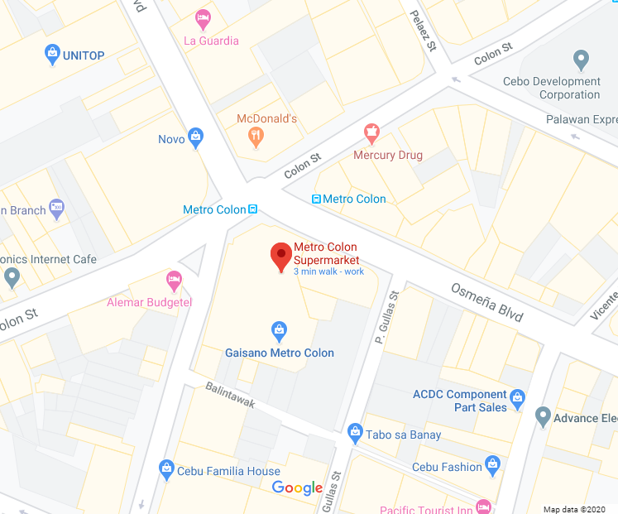
Research Methodology (Research Environment Map)

Slide 10
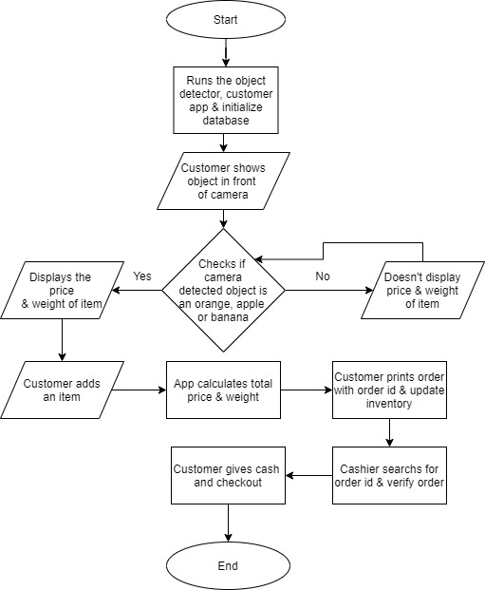
System Flowchart

Slide 11
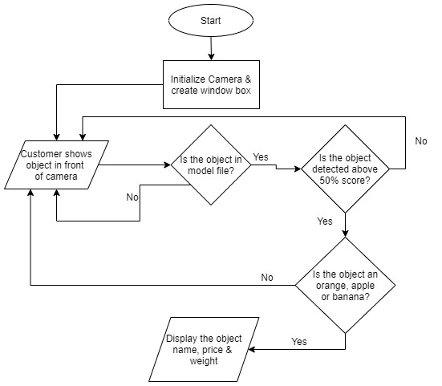
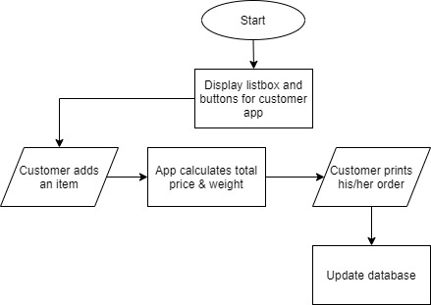
Program Flowchart
Object Detector
Customer app

Slide 12
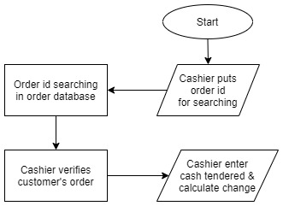
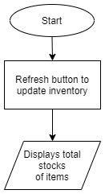
Program Flowchart (cont.)
Cashier App
Inventory App

Slide 13
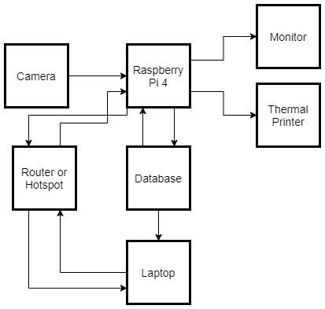
Block Diagram

Slide 14
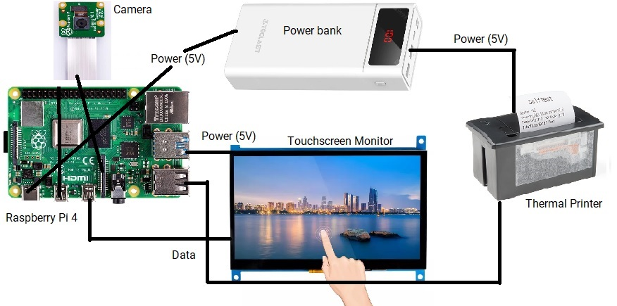
Schematic Diagram

Slide 15
Conclusions
Based on the findings from the data gathered, shopping experience needs to cope up with the technology today. Making innovative technology about shopping will help the customers less hassle and not a time consuming shopping.

Slide 16
Recommendations
Based on the findings of the study, the researchers highly recommended the following:
Import more objects to the model for object detection
Develop a more user friendly application for customers and cashier.

Slide 17
THANK YOU!! HAVE A NICE DAY!

